Slide 1




Exploratory Data Analysis on IMDb Movie Genre Dataset
Exploratory Data Analysis (EDA)
Team Members
Sreenitha Rayapuraju
Koushika Chappidi
Harshitha Reddy Mannemala
Sai Teja Kusireddy

Slide 2
ABSTRACT
This project explores the IMDb Movie Genre Dataset to uncover patterns and insights into movie metadata such as genres, descriptions, and titles. Using Python and various visualization tools, we investigate the linguistic and structural trends across movie genres. The findings can support genre prediction models and provide better understanding of movie data characteristics.

Slide 3
INTRODUCTION
Movies are a powerful medium of storytelling that span across cultures, languages, and genres. With the exponential growth of digital content, organizing and understanding movies through data-driven approaches has become essential. One of the key aspects of movie classification is genre prediction, which helps in content recommendation, user personalization, and market analysis.
This project leverages natural language processing (NLP) and machine learning to classify movie genres based on their plot overviews. By analyzing narrative structures and language patterns, we aim to uncover how textual descriptions align with genre labels, ultimately enhancing our ability to interpret and categorize cinematic content.

Slide 4
DATASET
This project utilizes two primary datasets to analyze and classify movie genres:
movies_genres.csv
Contains movie titles alongside their associated genres.
Each movie can belong to multiple genres, making this a multi-label classification problem.
Example genres: Action, Comedy, Drama, Horror, etc.
movies_overview.csv
Provides textual overviews or plot summaries for each movie.
This rich narrative content is used as the input for Natural Language Processing (NLP) and vectorization techniques.
Link:
https://www.kaggle.com/datasets/adilshamim8/nlp-task?resource=download

Slide 5
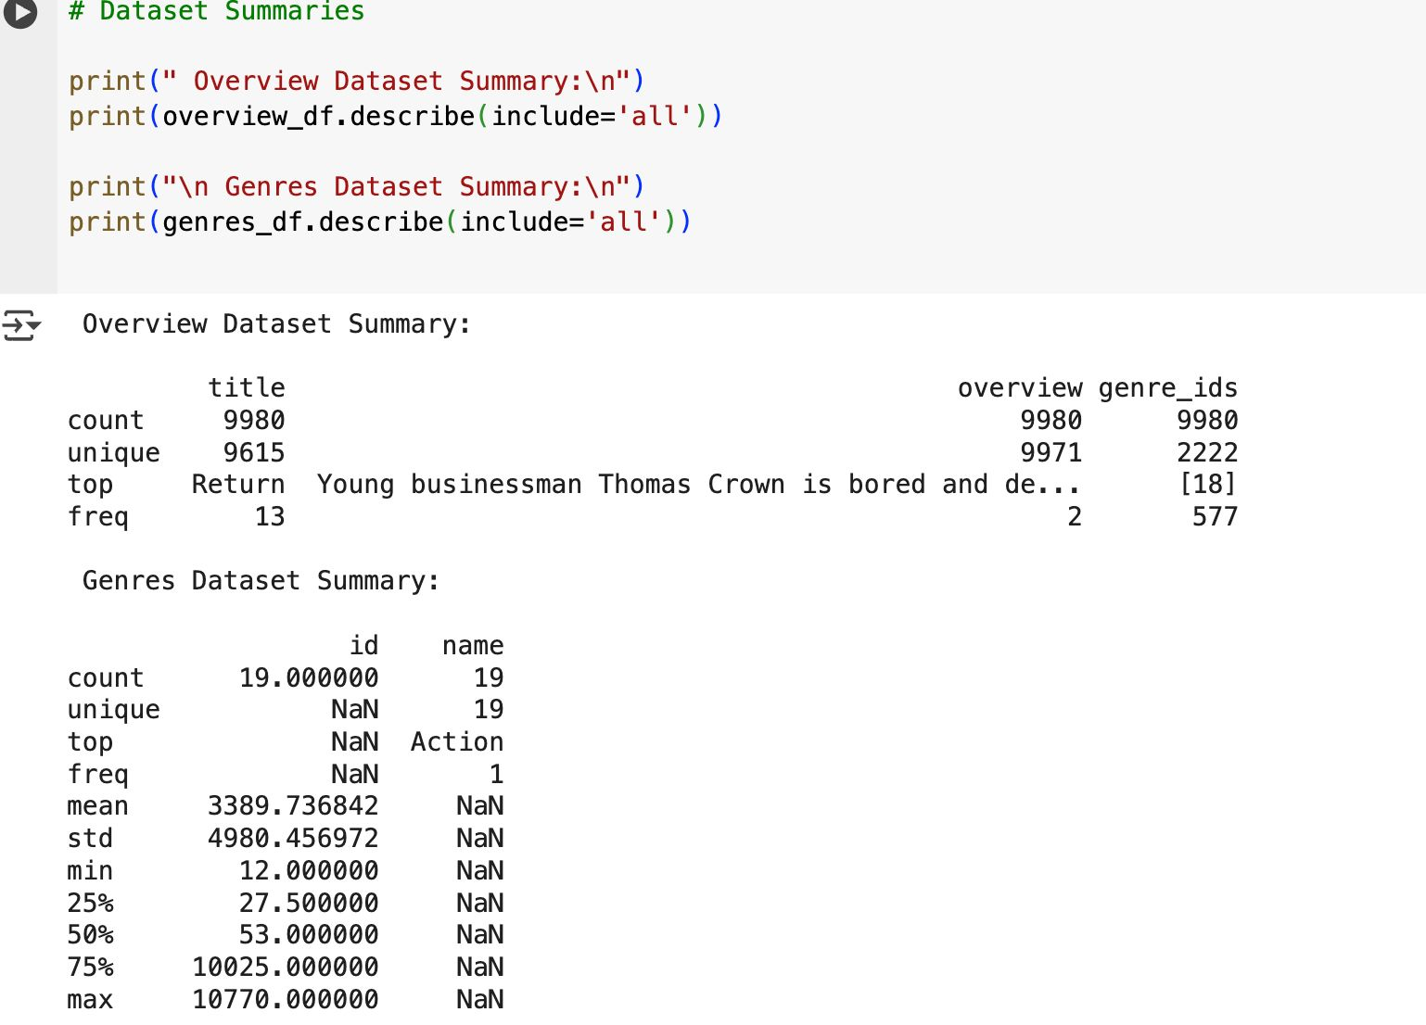
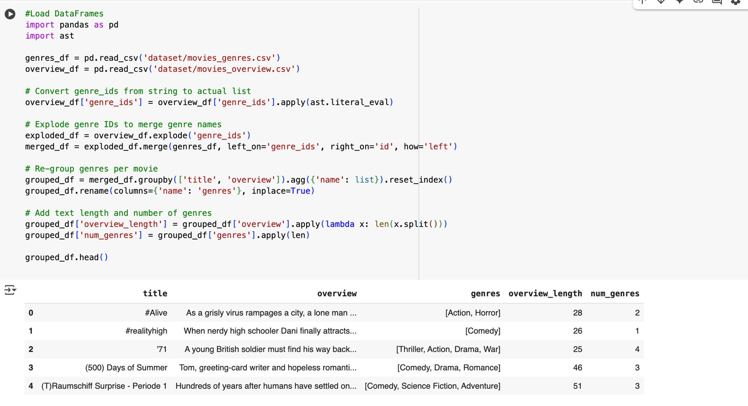
Importing and Summarizing Data

Slide 6

Dataset Merging: Combined movies_genres.csv and movies_overview.csv using movie title or ID.
Text Cleaning: Lowercased text, removed punctuation, numbers, and extra spaces.
Stop Words Removal: Removed common words like “the”, “is”, “and” that add little meaning.
Tokenization & Lemmatization: Split text into words and reduced them to their root forms.
Multi-label Binarization: Converted genres into a binary format for multi-label classification.
TF-IDF Vectorization: Transformed cleaned overviews into numerical features for modeling.
PREPROCESSING

Slide 7
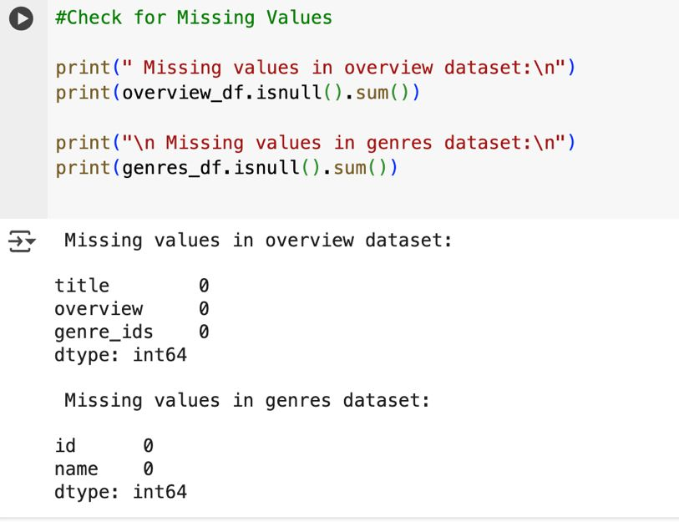
MISSING VALUES
During the preprocessing stage, the dataset was examined for missing values across all columns. Both movies_overview.csv and movies_genres.csv were found to be completely clean, with no missing values in any of the fields (title, overview, genre_ids, id, or name). This ensured that no imputation or removal was necessary, allowing for a smooth and uninterrupted analysis of all records.

Slide 8
EDA
Exploratory Data Analysis (EDA):EDA was performed to understand the distribution and relationships of movie metadata features. We analyzed both text-based and numerical variables using summary statistics and visualizations. Key insights were derived by grouping movies by genre and comparing characteristics such as overview length, title structure, and word usage complexity.
EDA Methodology:
Univariate Analysis: Frequency distribution of genres, overview lengths, and title lengths.
Bivariate Analysis: Relationship between overview length and number of genres, average word length vs. title length.
Boxplots: Used to detect outliers and compare text characteristics across genres.
Heatmaps: Explored genre co-occurrence patterns.
Bar Charts: Summarized average features by genre (overview length, title length, vocabulary).

Slide 9
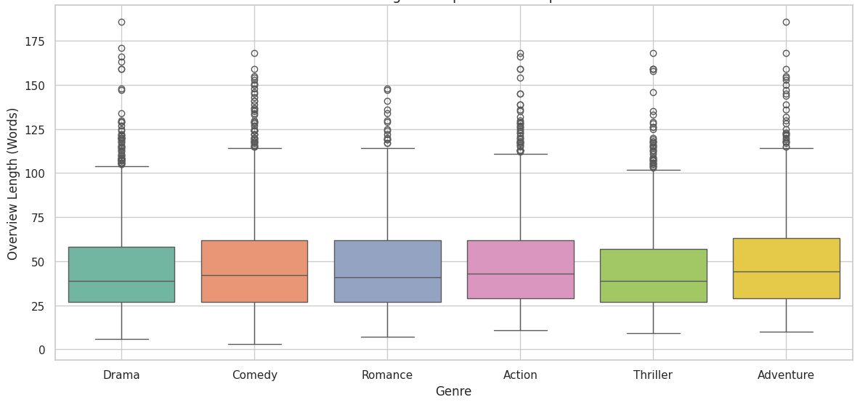
What We Did:Calculated how many words are in each movie’s overview.
Selected the top 6 most common genres.
Used a boxplot to compare overview lengths
across these genres.
What It Shows:Most overviews are around
30–50 words long.
Adventure, Romance, and Comedy tend to have
slightly longer overviews.

Slide 10
LITERATURE REVIEW
Genre Classification Using NLP Prior research has applied Natural Language Processing (NLP) to predict movie genres from plot summaries. Techniques like TF-IDF, Word2Vec, and Doc2Vec have shown effectiveness in capturing semantic meaning.
Machine Learning Approaches Classical models such as Logistic Regression, Support Vector Machines (SVM), and Naive Bayes are commonly used for text-based multi-label classification due to their interpretability and efficiency.
Deep Learning Models Recent studies leverage Recurrent Neural Networks (RNNs), LSTMs, and transformers (like BERT) to capture context and sequence information in text, significantly improving classification accuracy.
Challenges Noted Genre overlap, data imbalance, and ambiguity in text descriptions remain key challenges. Multi-label learning and ensemble techniques are suggested to mitigate these issues.

Slide 11
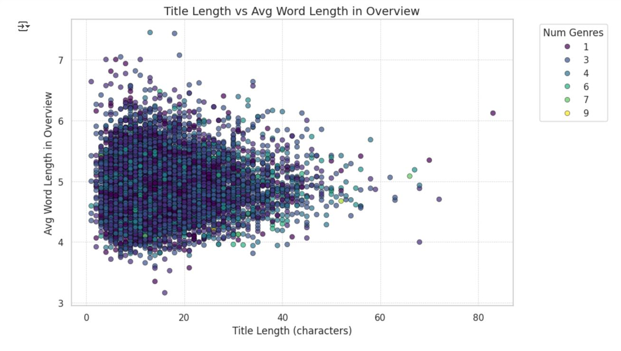
RESULTS
This scatter plot shows the relationship between title length and average word length in overviews, colored by the number of genres. Most movies have titles under 30 characters and use words averaging 4 to 6 characters in overviews. There's no strong correlation, but we observe that movies with a wider genre range (colored differently) are slightly more spread out in terms of complexity and title length.

Slide 12
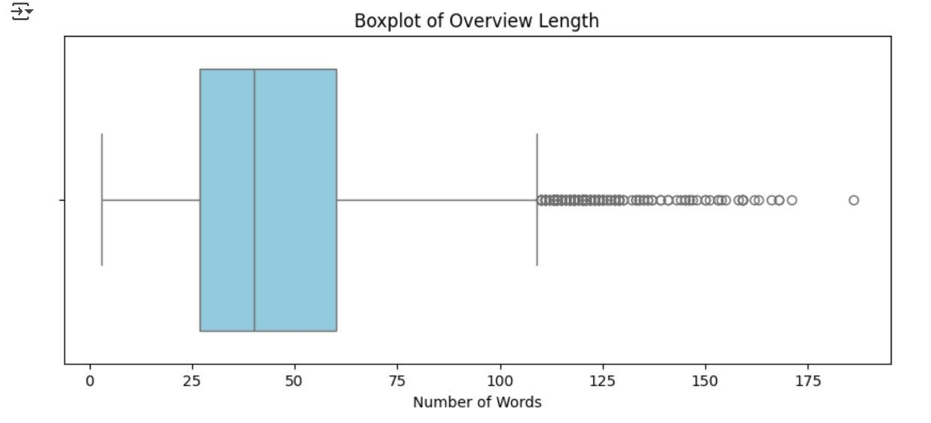
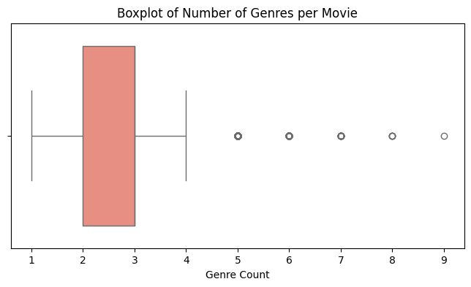
This boxplot displays the distribution of movie overview lengths by word count. Most overviews fall between 25 to 100 words, while values beyond that are treated as outliers. These outliers suggest a subset of movies have significantly more detailed descriptions.
This boxplot illustrates the distribution of the number of genres per movie. Most films have between 2 to 4 genres, with 3 being the median. Values above 5 are considered outliers, indicating a few movies are tagged with many genres.

Slide 13
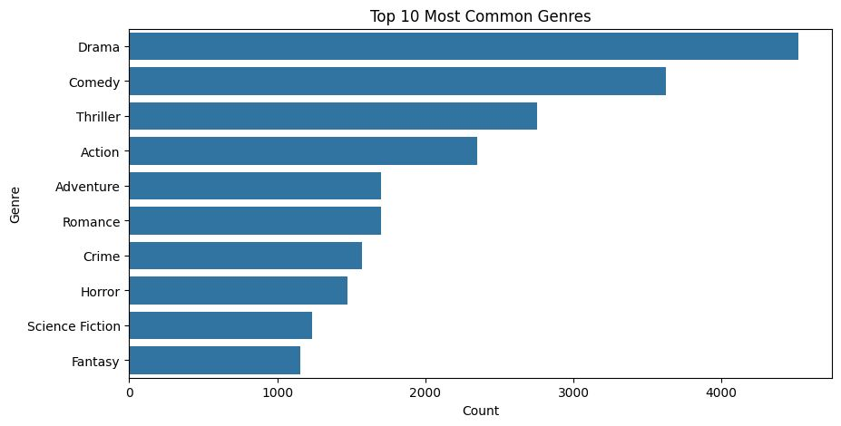
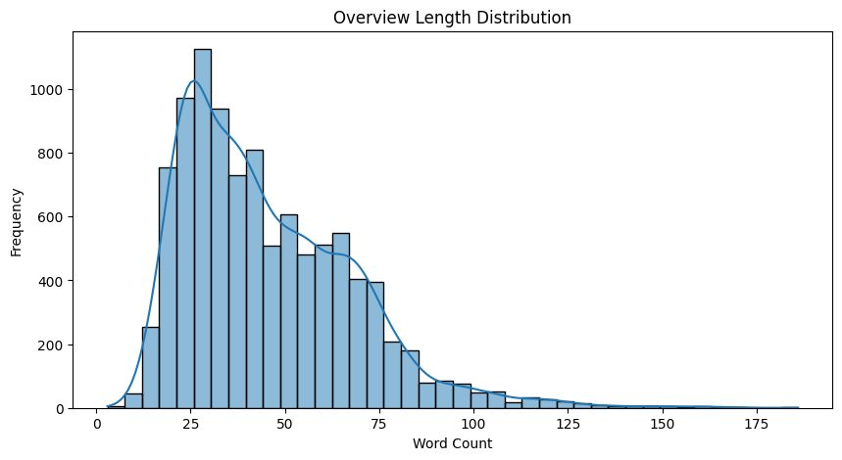
This bar chart shows the top 10 most common movie genres in the dataset based on frequency. Drama and Comedy are the most represented, followed by Thriller, Action, and Adventure. The graph highlights the dominance of emotionally driven and action-packed genres in modern cinema.
histogram visualizes the distribution of movie overview lengths. It uses sns.histplot to display the frequency of different word counts in movie overviews, with 40 bins and a kernel density estimate for a smoother curve

Slide 14
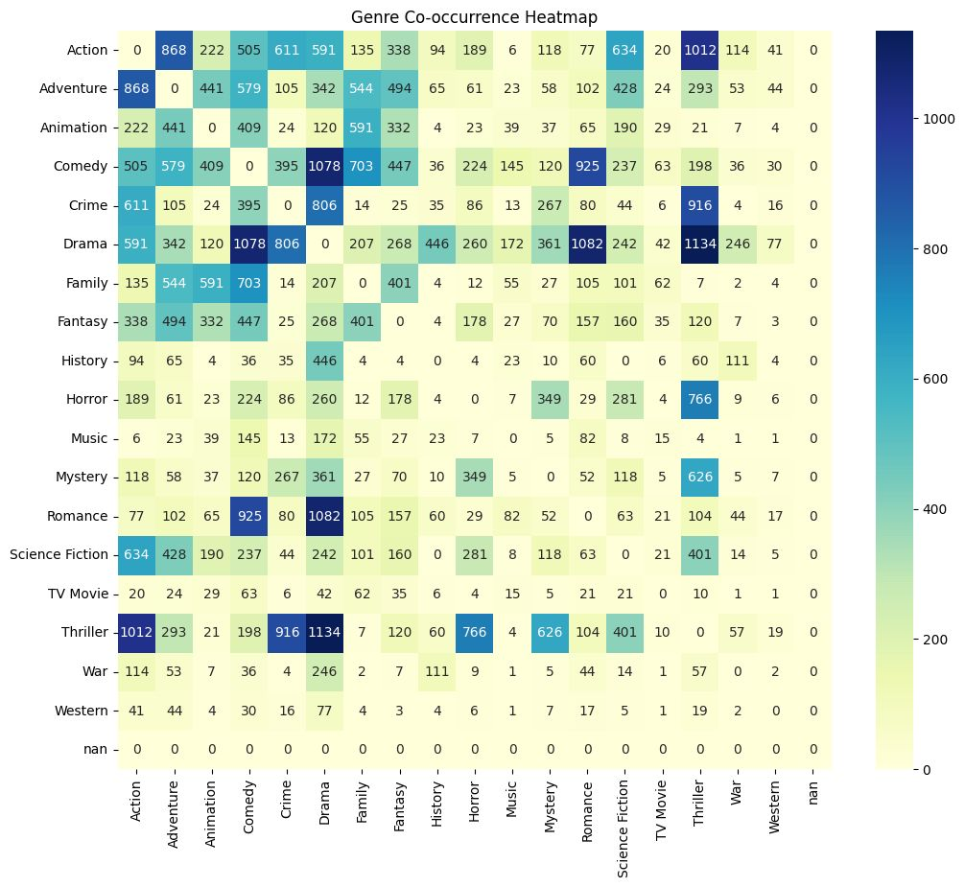
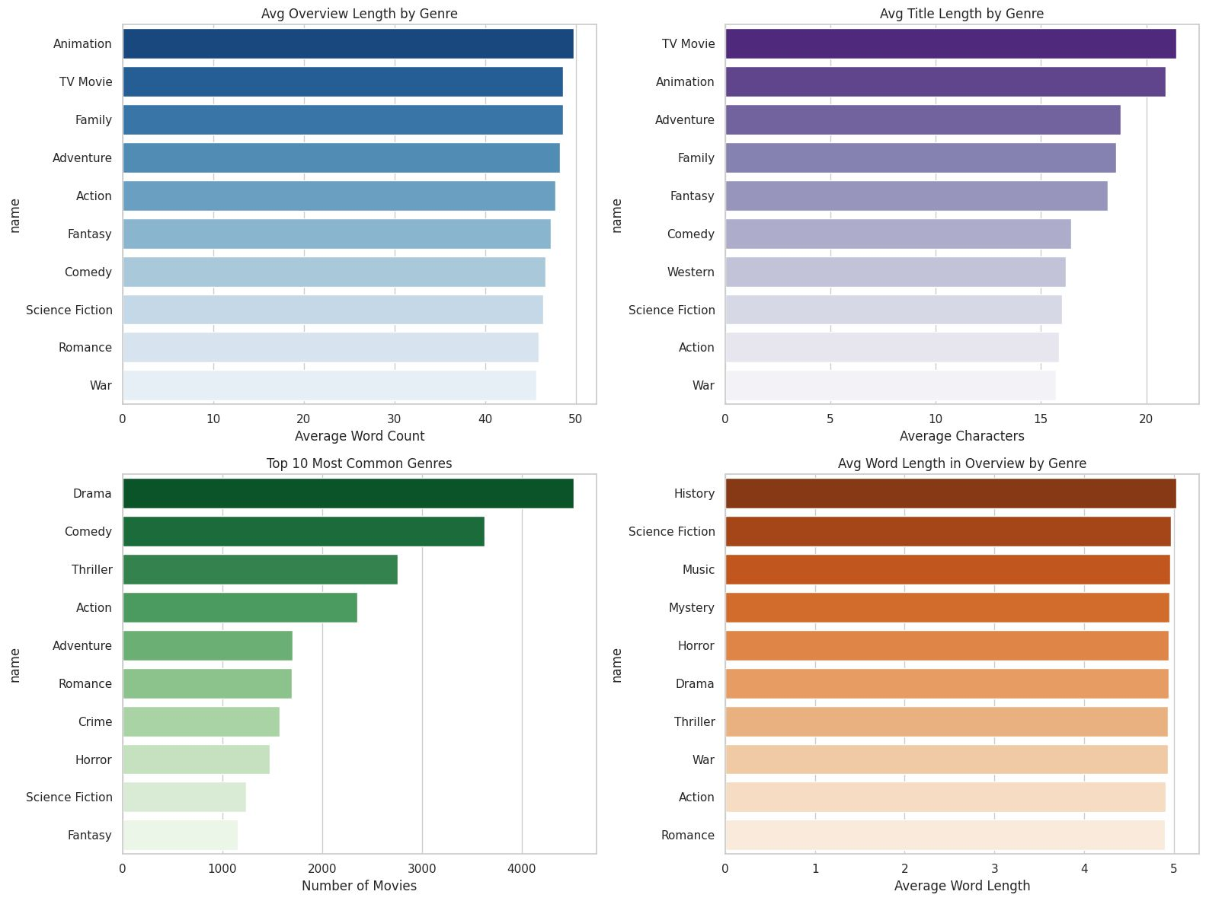
The heatmap shows that Drama frequently co-occurs with genres like Thriller, Romance, and Crime. Strong pairings are also seen between Action & Adventure and Comedy & Romance. This highlights popular genre combinations used in multi-genre films for broader audience appeal.
This dashboard compares genre-based averages for overview length, title length, and word complexity. Animation and TV Movies have the longest overviews and titles, while Drama is the most frequent genre. History and Sci-Fi use the most complex vocabulary in movie descriptions.

Slide 15
CONCLUSION
Key Takeaways:
Drama, Comedy, and Thriller are the most frequent genres in the dataset.
Movies with multiple genres tend to have longer overviews.
Genre-based differences were found in title length, overview length, and word complexity.
Outliers in text length were more common in genres like Action and Drama.
Genres like History and Science Fiction used more complex vocabulary.
Overall Insight:
Text-based metadata (title and overview) holds strong potential for genre prediction and can be valuable in recommendation systems or content classification.

Slide 16
Recommendations and Further Analysis:
Deeper Genre Analysis: Investigating the co-occurrence of genres further to uncover potential thematic relationships and build genre-based recommendation systems.
Sentiment Analysis of Overviews: Analyzing the sentiment expressed in movie overviews to understand the emotional tone associated with different genres.
Predictive Modeling: Exploring the possibility of predicting movie ratings or success based on features like overview length, title length, genre combination, and sentiment.
Incorporating External Data: Adding external data sources, such as cast information, director details, or budget data, to enhance the analysis and build more comprehensive models.

Slide 17
REFERENCES
Adil Shamim (2023). IMDb NLP Task Dataset: https://www.kaggle.com/datasets/adilshamim8/nlp-task
Chandekar, P., & Patil, A. (2021). BERT-based Genre Classification for Movie Plots.
International Journal of Computer Applications (IJCA)
Nanda, R., & Sharma, S. (2022). Sequence Models for Movie Genre Prediction.IEEE Access, Vol. 10, pp. 12345–12357
Basak, S., & Choudhury, M. (2020). Co-occurrence-Based Genre Modeling for Content Analytics.
Elsevier, Journal of Big Data

Slide 18
GITHUB RESITORY FOR CODE
https://github.com/tejakusireddy/movie-genre-overview-eda

